Slide 1
Daft Software of Dispensing Machine
Detail: Date 29 April 2025
Description: ?
Author : Atthaphan Paksakunnee 524161

Slide 2
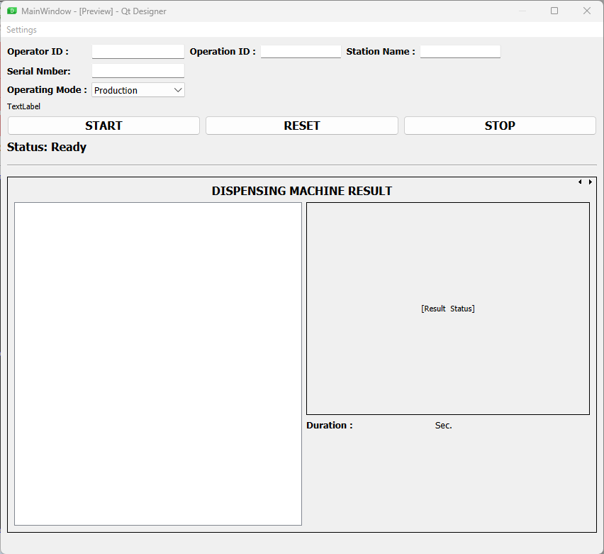


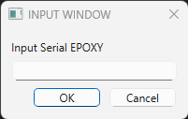

GUI Software
1.
Auto Gen
Auto Gen
2.
3.
5. Logs will appear here...
Change Status: Running
4.
6. Duration of process start to end

Slide 3
HW Scheme
Barcode Reader
PC + Monitor
FITs
USB
API
I/O
Nordson
Dispense Robots
OptiSure

Slide 4
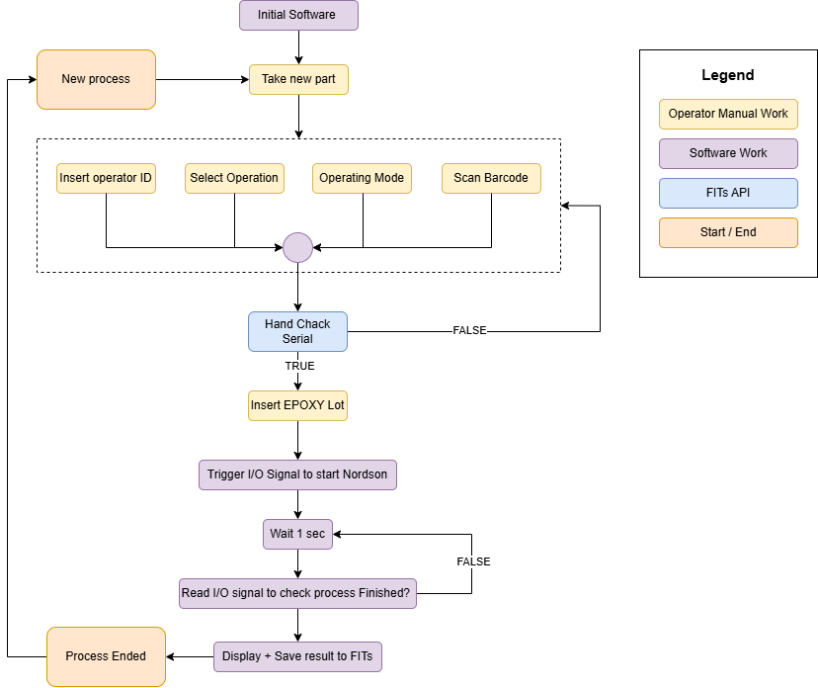
Workflow Scheme

Slide 5
Data Logging
Result data stored in correct format .csv file in local storage
Station ID
Operator ID
Timestamp
Barcode
program number
Result
Error code
Image (TBD)

